Slide 1
Lifetime achievement award
Michael Shambaugh

Slide 3
Mike Shambaugh has been a Legacy Park resident since 1995. Like many others, he and his wife moved to Legacy Park because they saw the potential of this community and wanted to raise their family here. The Shambaughs started out in Highcroft, and moved to Revere after 12 years. 24 years later, Legacy Park is still home.

Slide 4
Volunteerism
Mike began his legacy of volunteerism by coaching soccer.
Our lives are enriched by the people who take the time to coach, to teach, and to build up a team that allows children to explore what they want to be and learn how they can exceed their expectations.

Slide 5
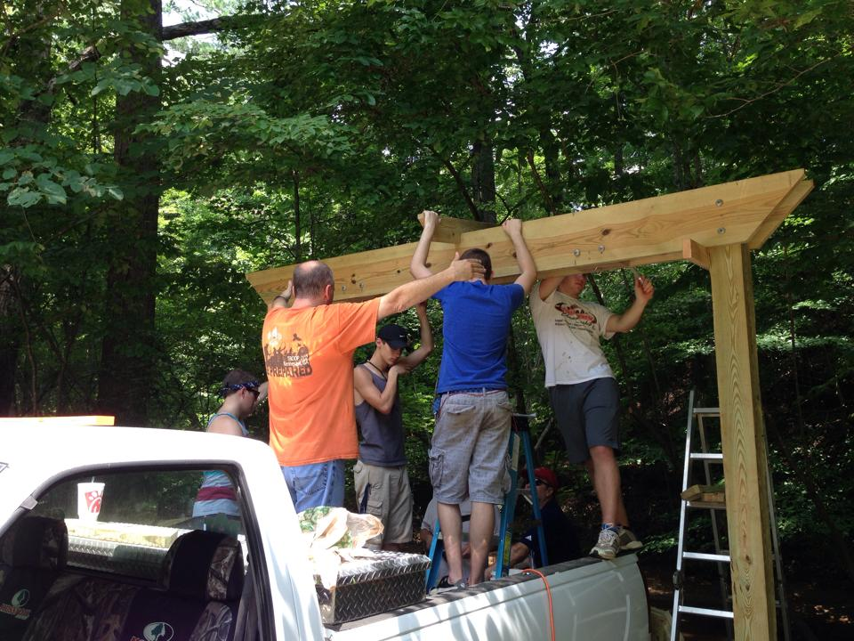
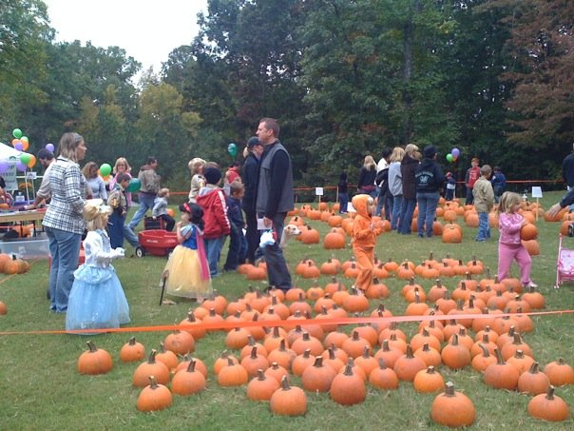
Mike was an integral part of creating Legacy Park Boy Scout Troop 2 when the boys in the Cub Scout Pack were of age to move up. He was awarded the William D. Boyce New-Unit Organizer Award for this work. He focused the scouts’ energy on community service, which is evident around Town Green with the addition of benches and swings along the trails. Through Mike’s efforts, Troop 2 has achieved one of the highest percentages of Eagle Scouts in Georgia.
Pack 002
Troop 2

Slide 6
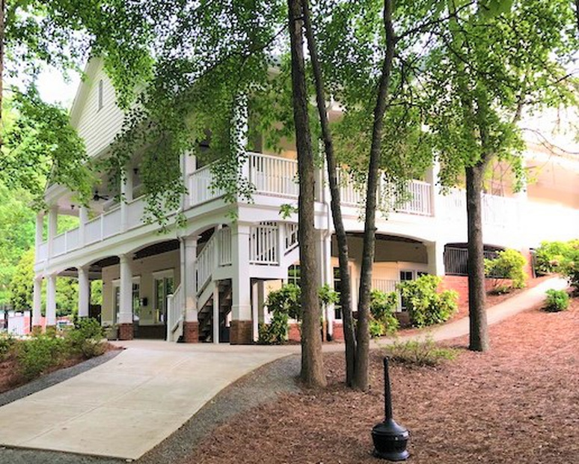
Board of Directors
In 2008, Mike was elected to the HOA Board of Directors. During his time on the board, he was instrumental in the construction of the Clubhouse, and he redefined the role of Treasurer. Mike served until 2010, then returned to finish the term of a board member who resigned in 2011.
In 2013, Mike volunteered his time to overhaul the voting system to utilize electronic voting. This system is still in place now.

Slide 7
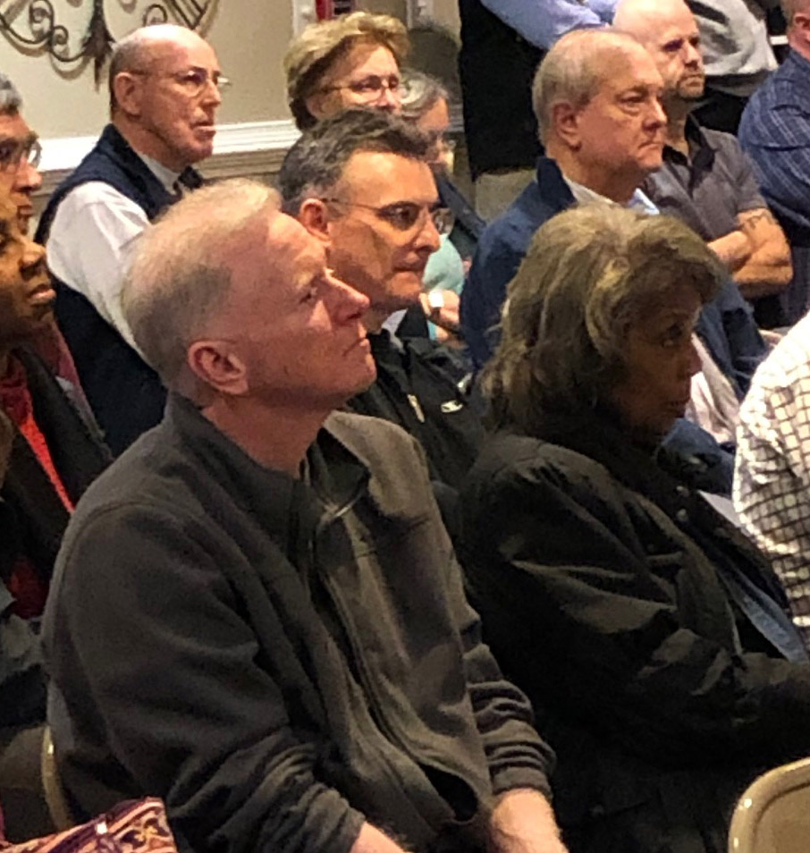
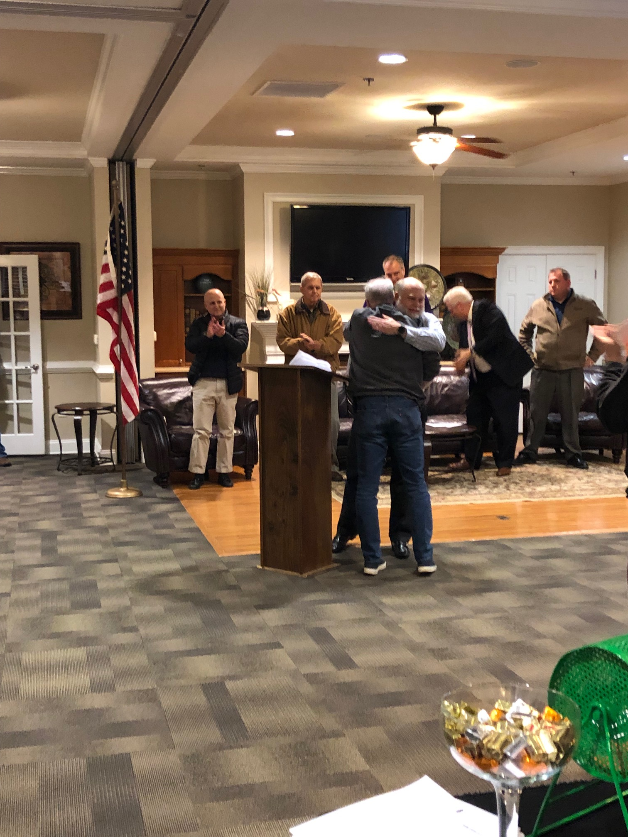
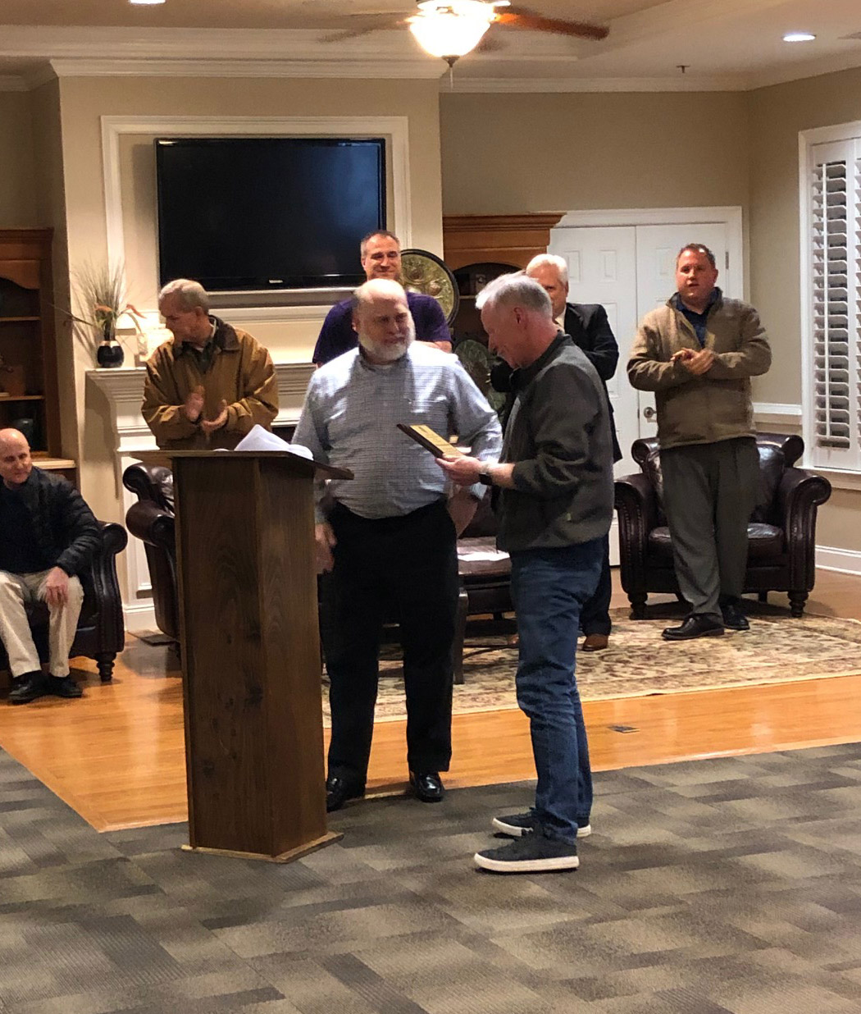
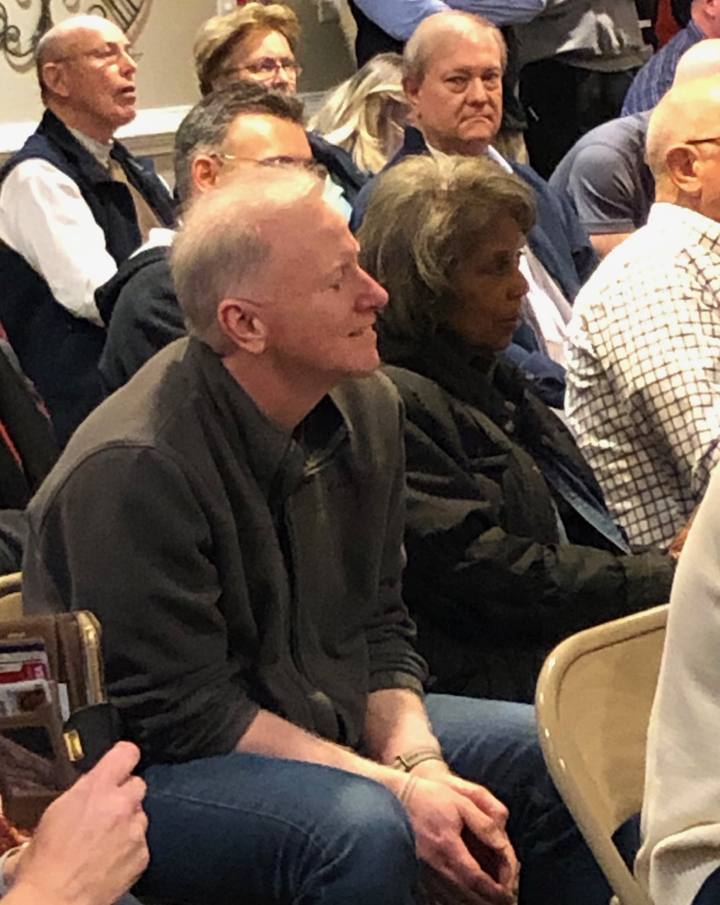

Slide 8
Thank you, Mike, for your continued commitment to our community.
Thank you, Tina, Ted, and Kate for sharing him with us.

